Slide 1

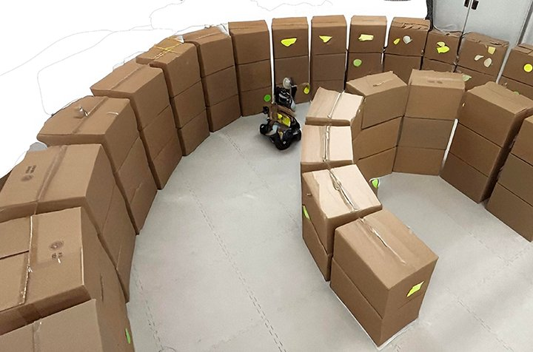
UAV Flight-Control using finite-state witchcraft
ME/SE 740 Quad Chart | Mid-term Progress Report
1 | Project Objective & Scope Changes Since Proposal
2 | Research Approach
State the core objective of your project.
Changes since proposal:
Describe any scope, method, or focus changes since the original proposal.
Describe your methodology and research strategy.
Research tools and objectives:
3D printing of flapping wing assembly
Customized Python to STL converter
. . .
Rationale:
Explain why this approach is appropriate for your research question.
All reports should include a photo or graphic
3 | Milestones: Tasks Finished & Tasks Remaining
4 | Timeline & Final Deliverables
✔ Tasks Completed
Completed task or milestone 1
Completed task or milestone 2
Completed task or milestone 3
◷ Tasks Remaining
Remaining task or milestone 1
Remaining task or milestone 2
Remaining task or milestone 3
Timeline (replace with your actual schedule):
W0
W1
W2
W3
W4
W5
W6
W7
W8
Literature Review
Data Collection
Analysis
Draft Report
Final Deliverable
Final Deliverables: Describe what will be submitted or presented at the end of the term.
Student Name: | Date:

